Slide 1
Vexilum Signifer

Slide 2
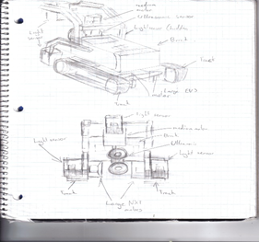

Preliminary Design 1

Slide 3
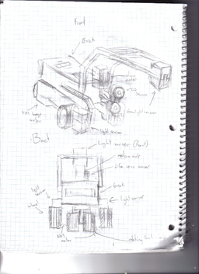
Preliminary Design 2

Slide 4
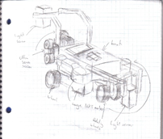
Preliminary Design 3

Slide 5
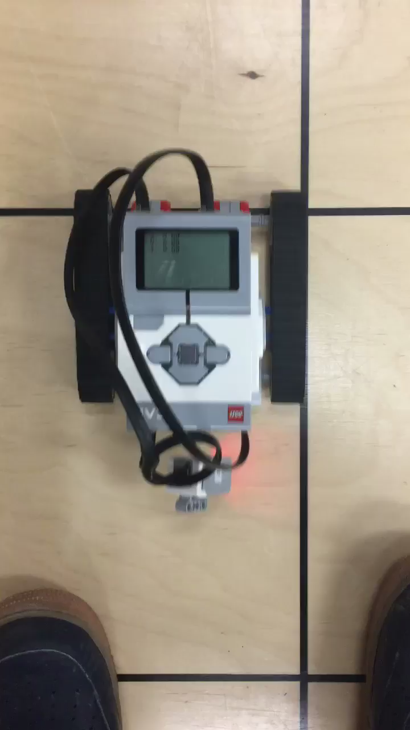
Preliminary Design 1

Slide 6
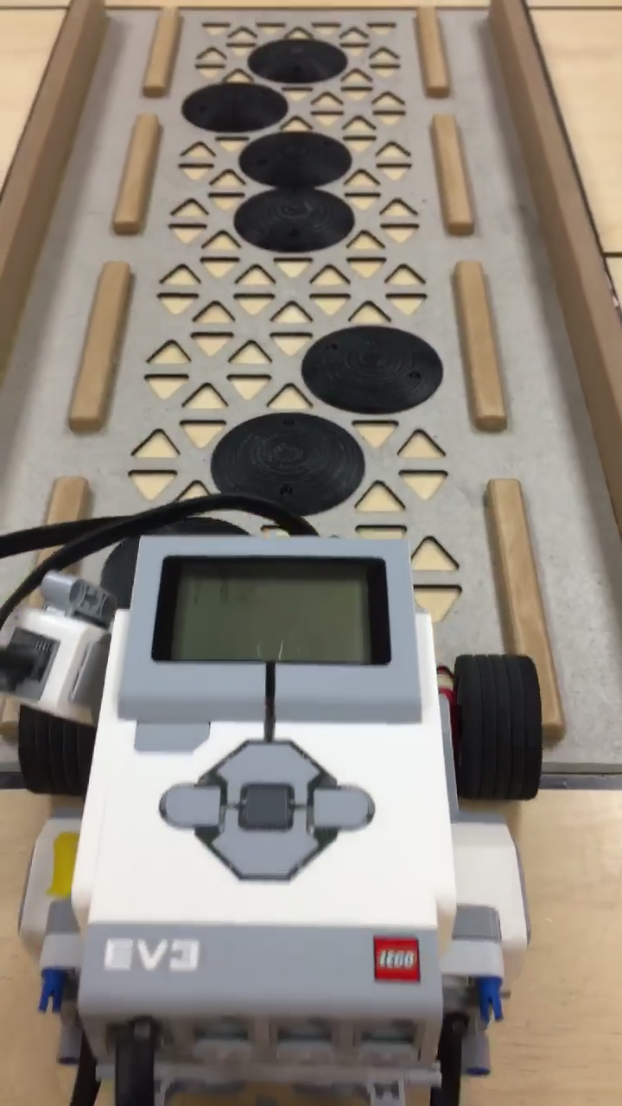
Preliminary Design 2

Slide 7
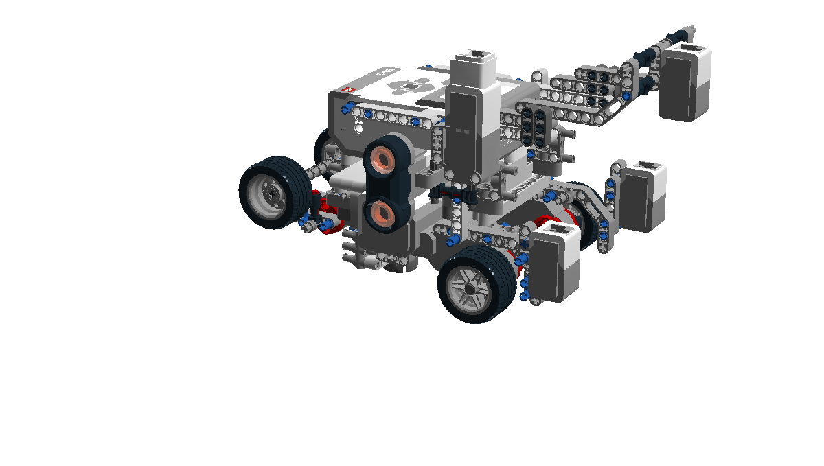
Design 1.0

Slide 8
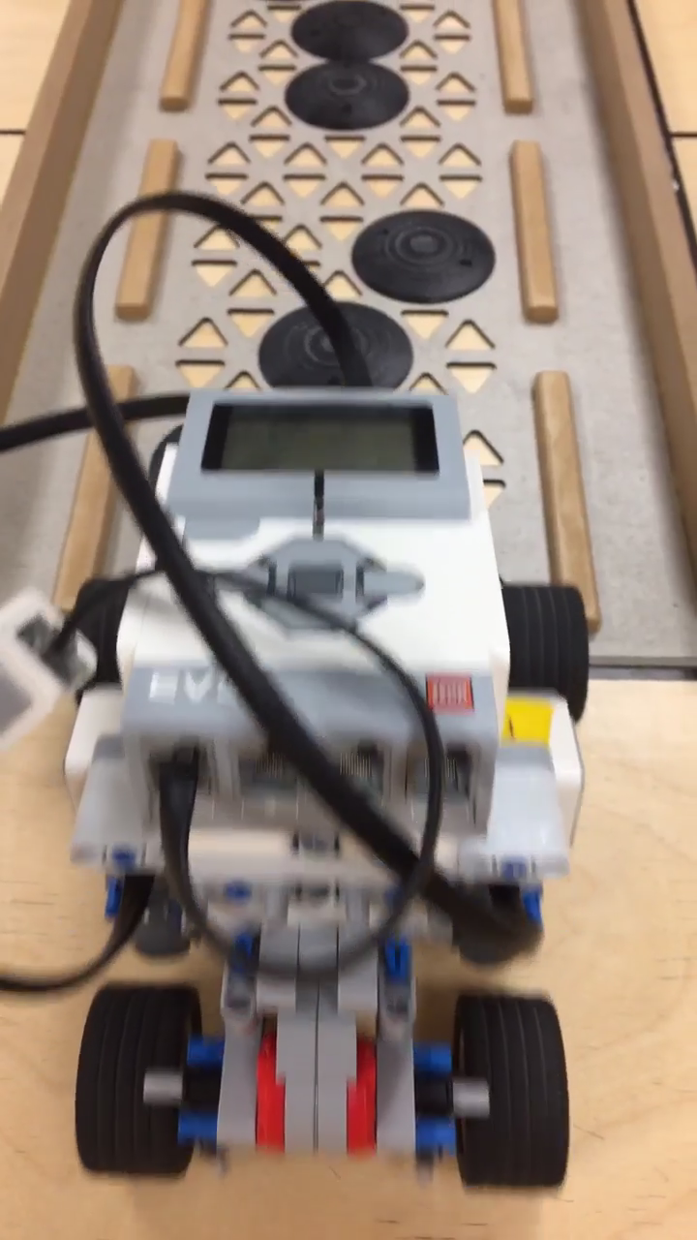
Design 1.0

Slide 9
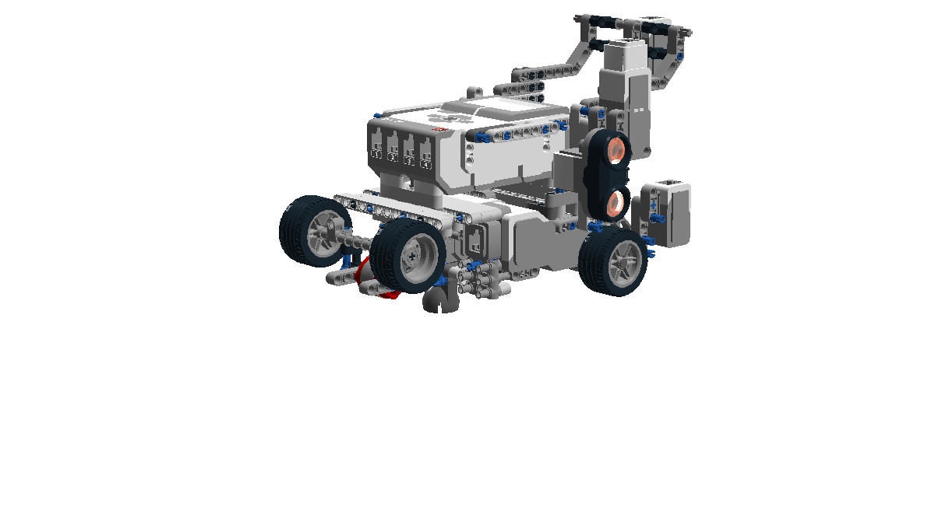
Design 1.1

Slide 10
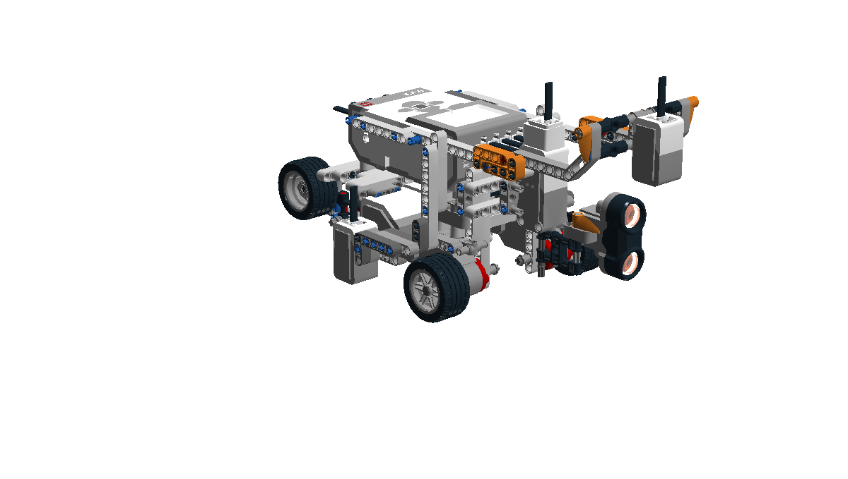
Design 2.0

Slide 11
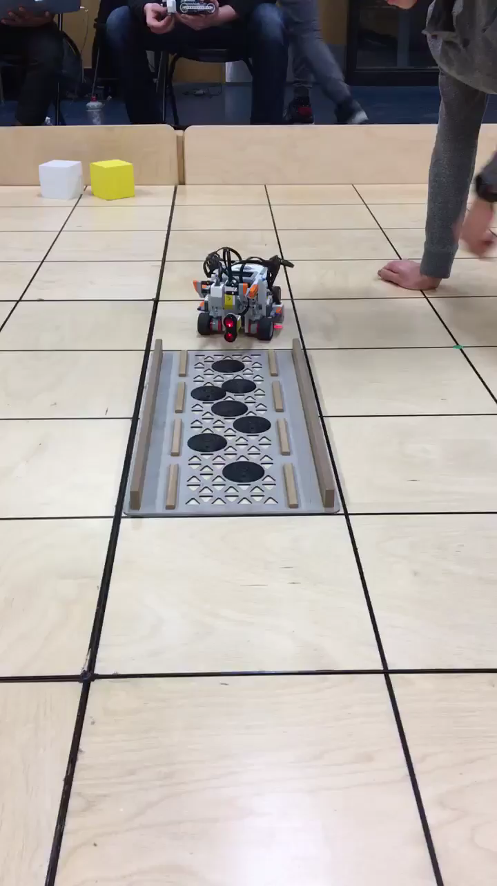
Design 2.0

Slide 12
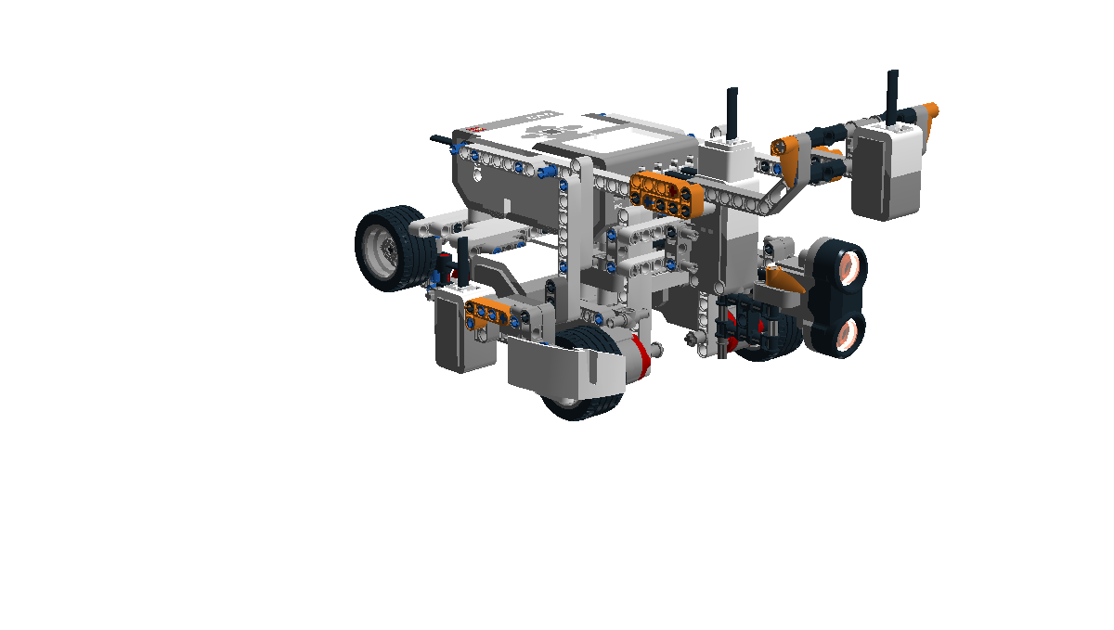
Design 2.1

Slide 13
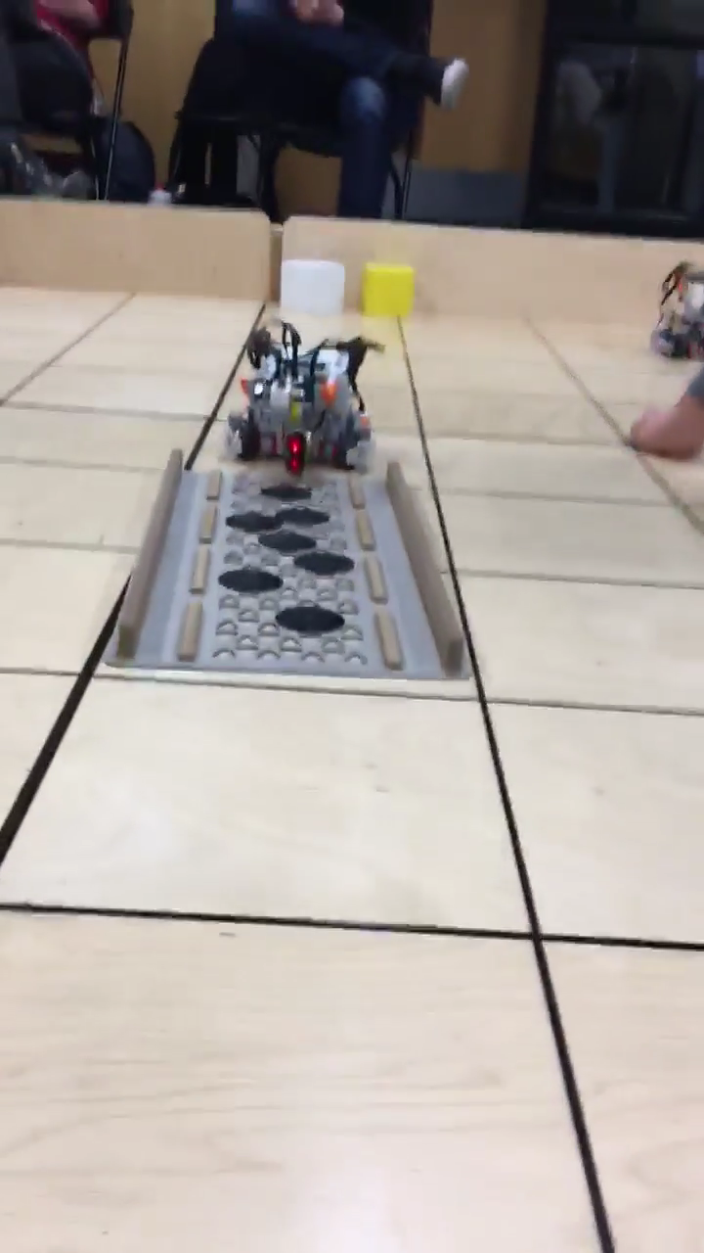
Design 2.1

